Slide 1
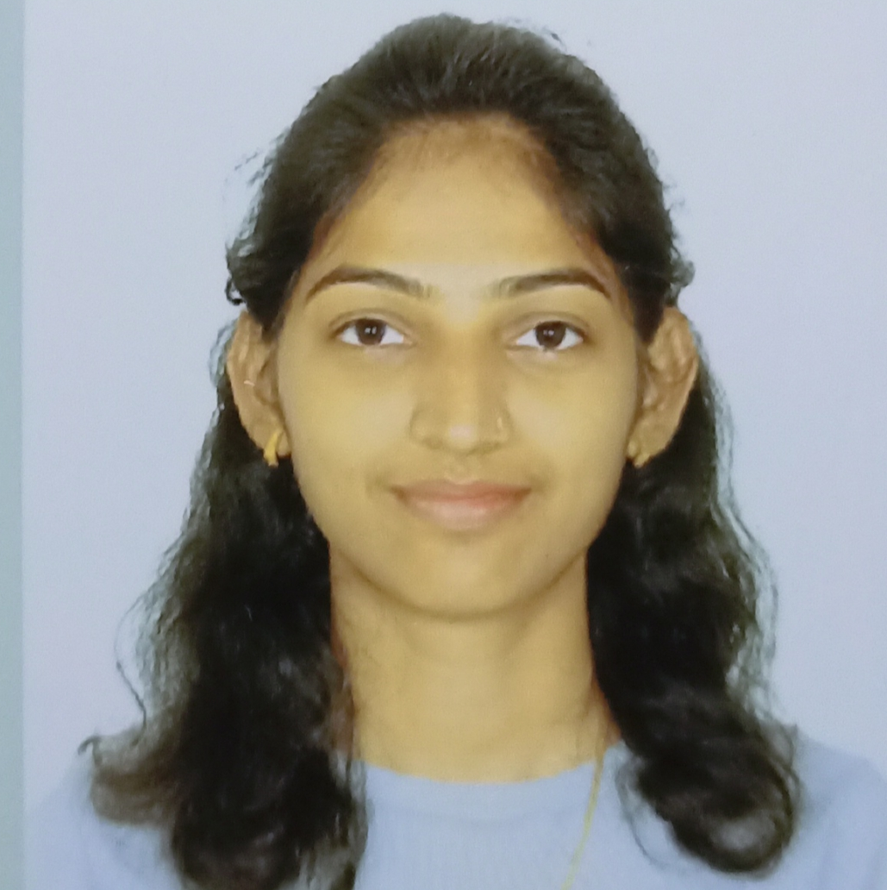

Sujita Dabekar
Analyst/Software Engineer
Bachelor of Engineering,
Electronics & Telecommunication Engineering : 2019-22
Skills
Mumbai
C# | Basics, OOPS, Exception Handling ,Arrays ,Collection and Generics.
.NET Framework | ADO.NET, .NET 5 WEB API, Entity Framework , ASP .NET with MVC5.
Database | SQL
Tools | GIT,VISUAL STUDIO,VISUAL STUDIO CODE,SSMS.
UI Technology | HTML5 ,CSS & Angular
Add On Skills | Communication Skills, Team Management
sujita-bhagoji.dabekar@capgemini.com
+91 7248990236
A4
RollOff System for Employees.
Developed a WEB APPLICATION as part of case study using .NET WEBAPI , & ANGULAR.
Develop a project which helps to Roll off the employee. This project should act as a communication among Accounts team, PSP and admin. This web application automates and minimize the time off roll off process via email.
Version 1.0 include Searching employee and displaying details and requesting for rolloff.
Version 1.2 will include Accepting and rejecting rolloff , showing pending requests and sending mail to employees.
Tools Used:
Visual Studio 2022 & VS code
Full Stack Developer
Understanding of RDBMS concepts using SQL Server.
Practical understanding of C# and SQL concepts using Visual Studio and SQL Server
Good understanding on concepts of Oops concepts(Abstraction, Encapsulation , Inheritance, polymorphism)
Hands on experience in developing applications using .NET Core
GitHubLink

